Slide 1





Bigger Then Data (BTD)
Abdullah Alhuwaishel
Jumana Almussa
Afnan Alzahrani
Mahmoud Alhassan
Amjad Almusallam

Slide 2

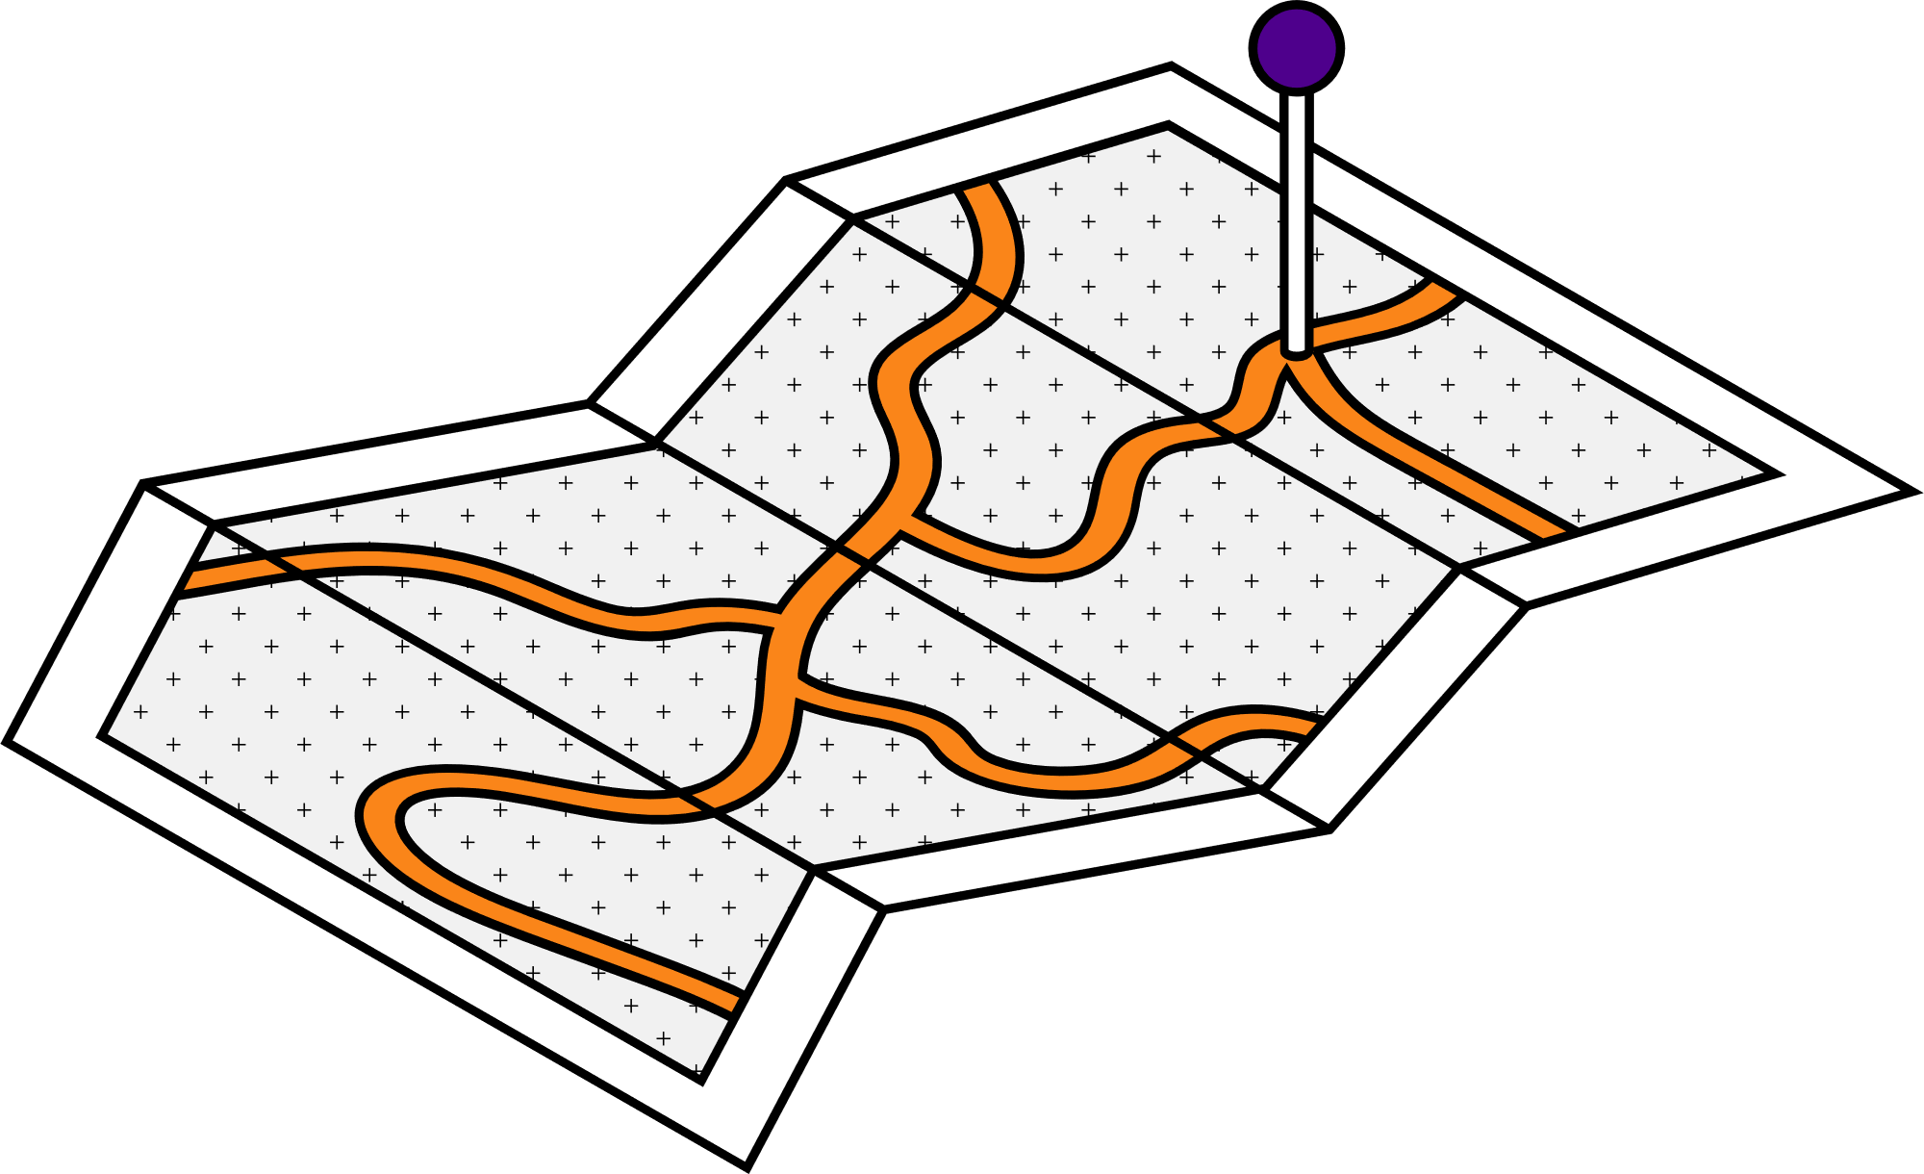
Contents
Vision
2030
Our
target
Recommendation System
Dashboard
About
Stc & Stc-tv
Stc-tv
dataset
Preprocessing
Results

Slide 3

One of the programs of the 2030 vision (Quality of Life) which focus on improving the quality of life for the people & families.

Slide 4


One of the Saudi digital companies who contribute on in improving the life of the individual & families is STC.

Slide 5
STC TV is an entertainment streaming service that provide you with the best movies, tv shows, documentaries, kids shows & more.

Slide 6

So our target for this project is to contribute efficiently in developing a recommendation system for the viewer which will improve his quality of life, with the implementing the latest AI technology.

Slide 7


Recommendation Systems
are a type of information filtering systems as they improve the quality of search results and provides items that are more relevant to the search item or are realted to the search history of the user.

Slide 8
STC website provides the STC-TV dataset that was used in this case study
It consists of 13 columns and 3598607 rows
We used another dataset from STC-TV that had the same columns but with an additional column called "rating" and it had 1048575 rows
Stc-tv
dataset
Columns :
User_id_maped, Date, Program_name, Duration_seconds, Program_class, Season, Episode,
Program_desc, Preogram genre, Series_title, HD, Original_name , rating

Slide 9

Dashboard

Slide 10
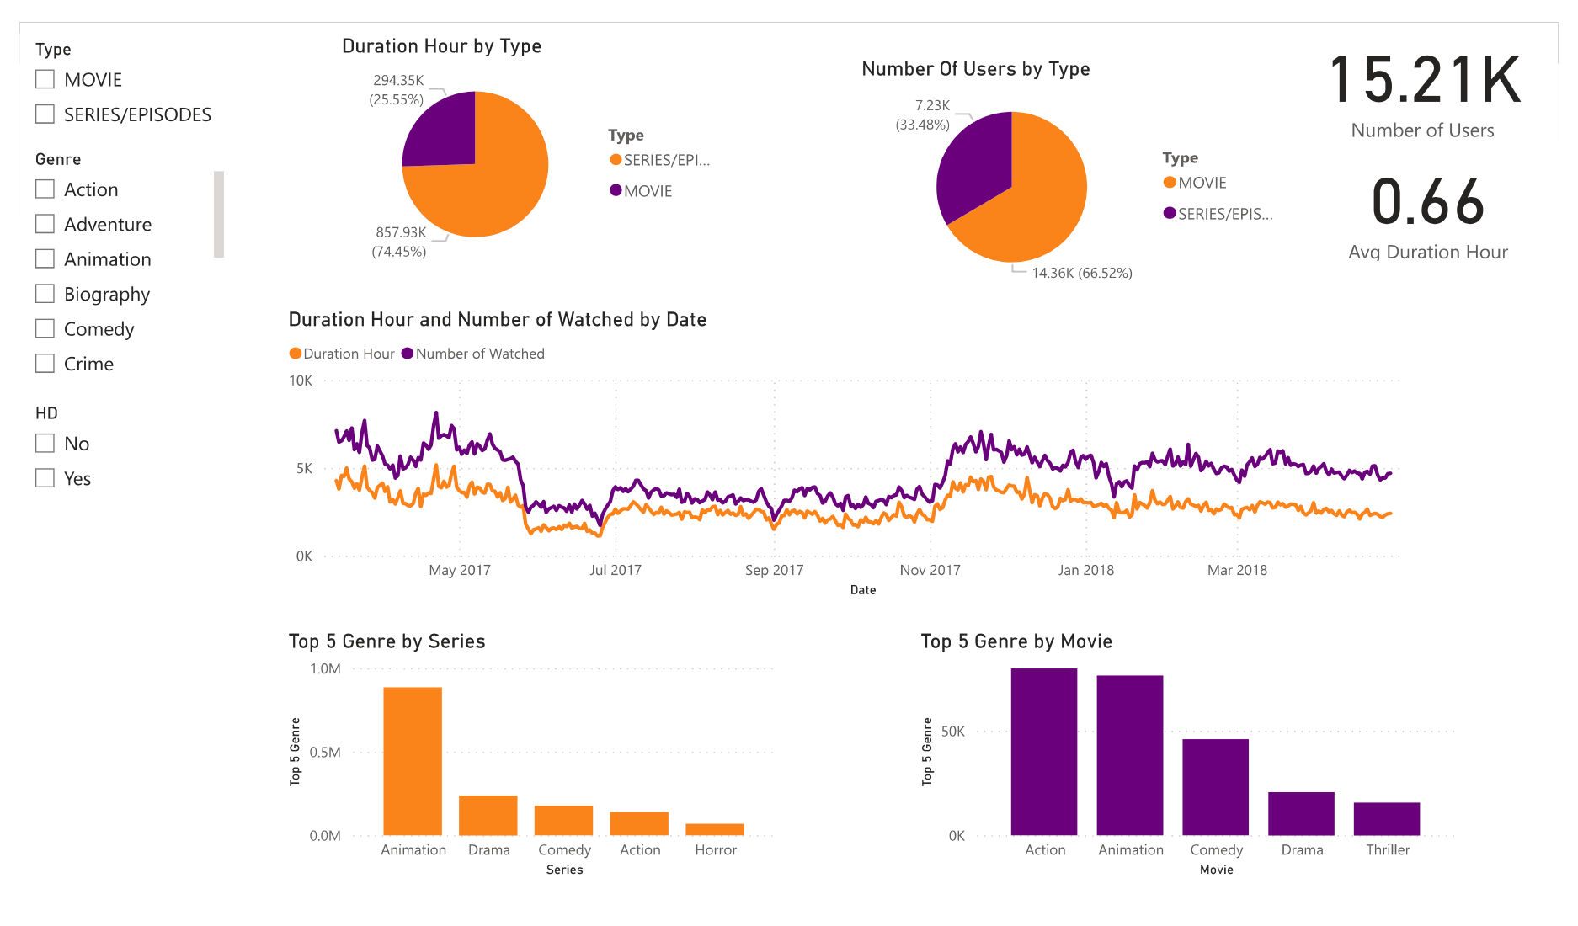

Slide 11
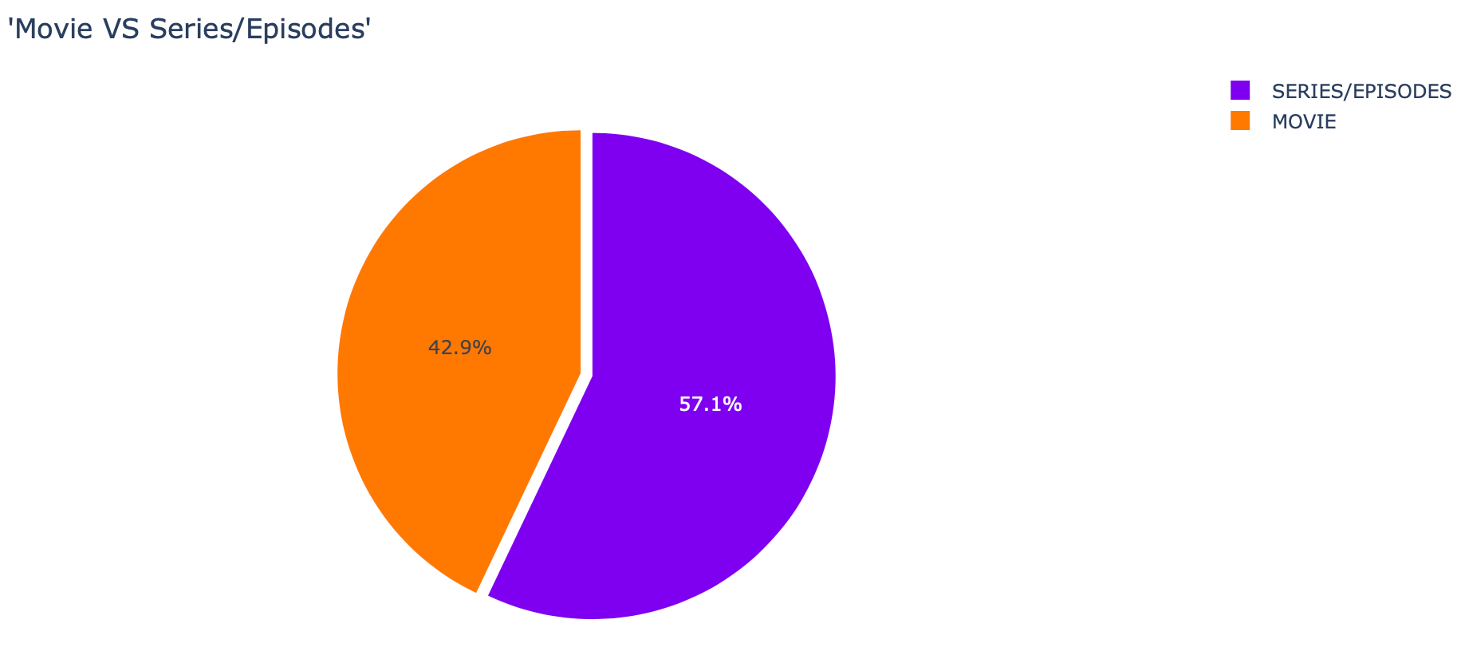
The percentage of movies and series that STC-TV have.

Slide 12
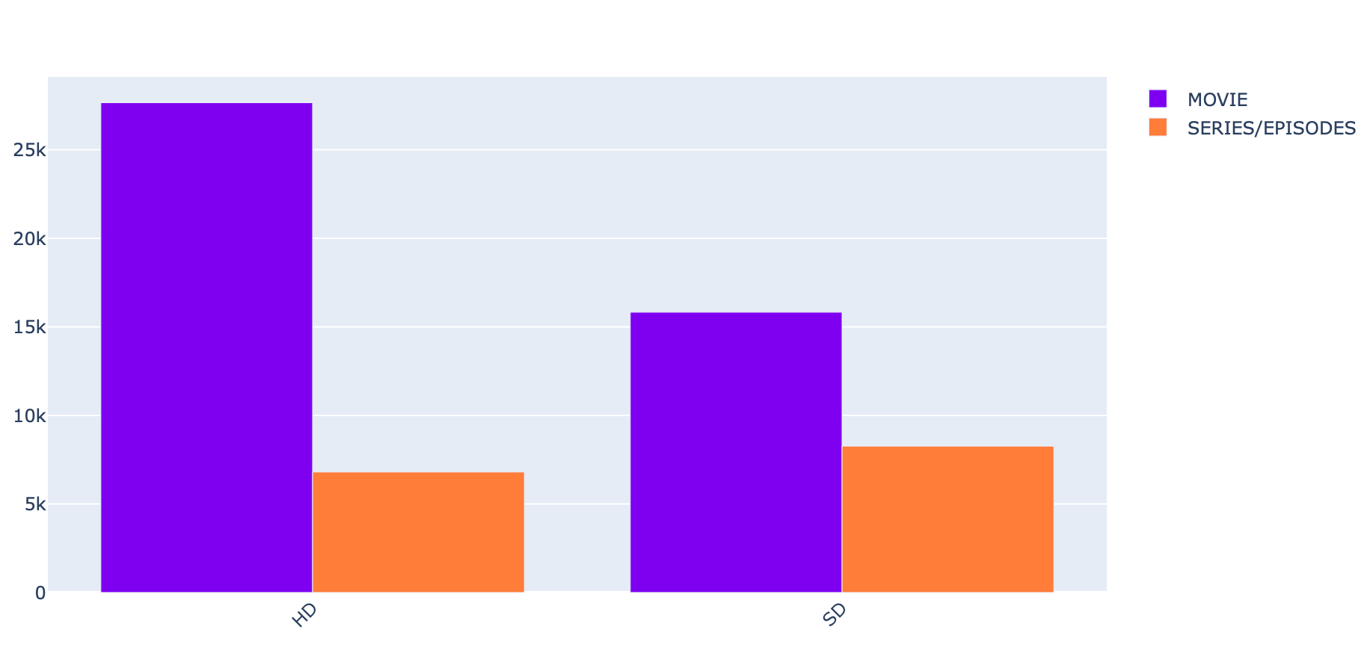

Slide 13
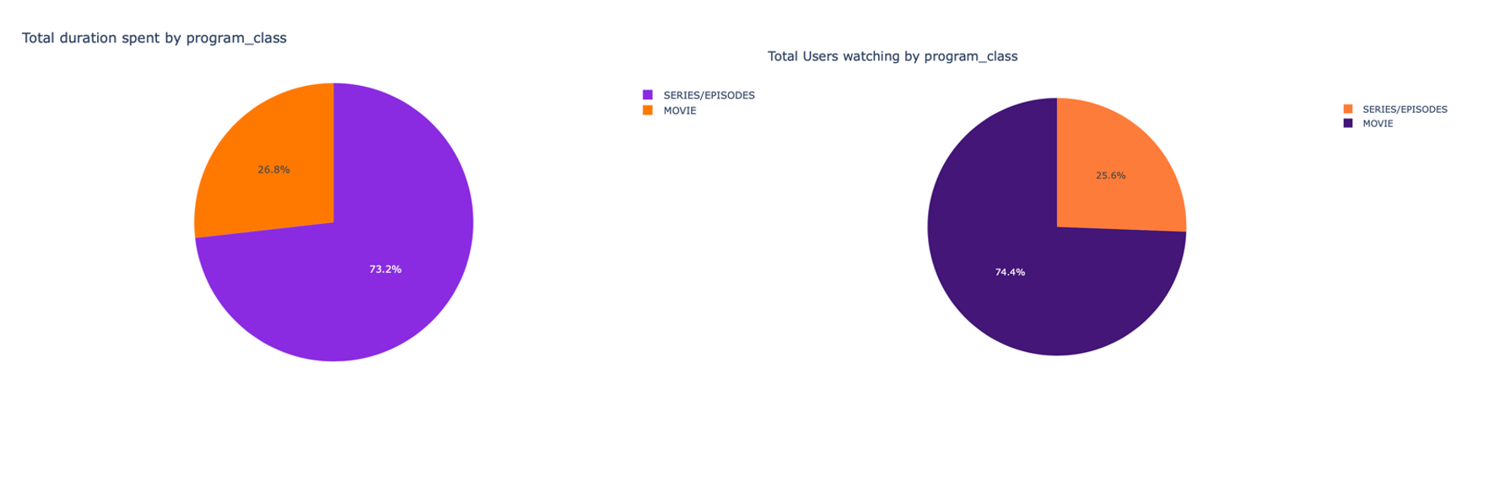

Slide 14
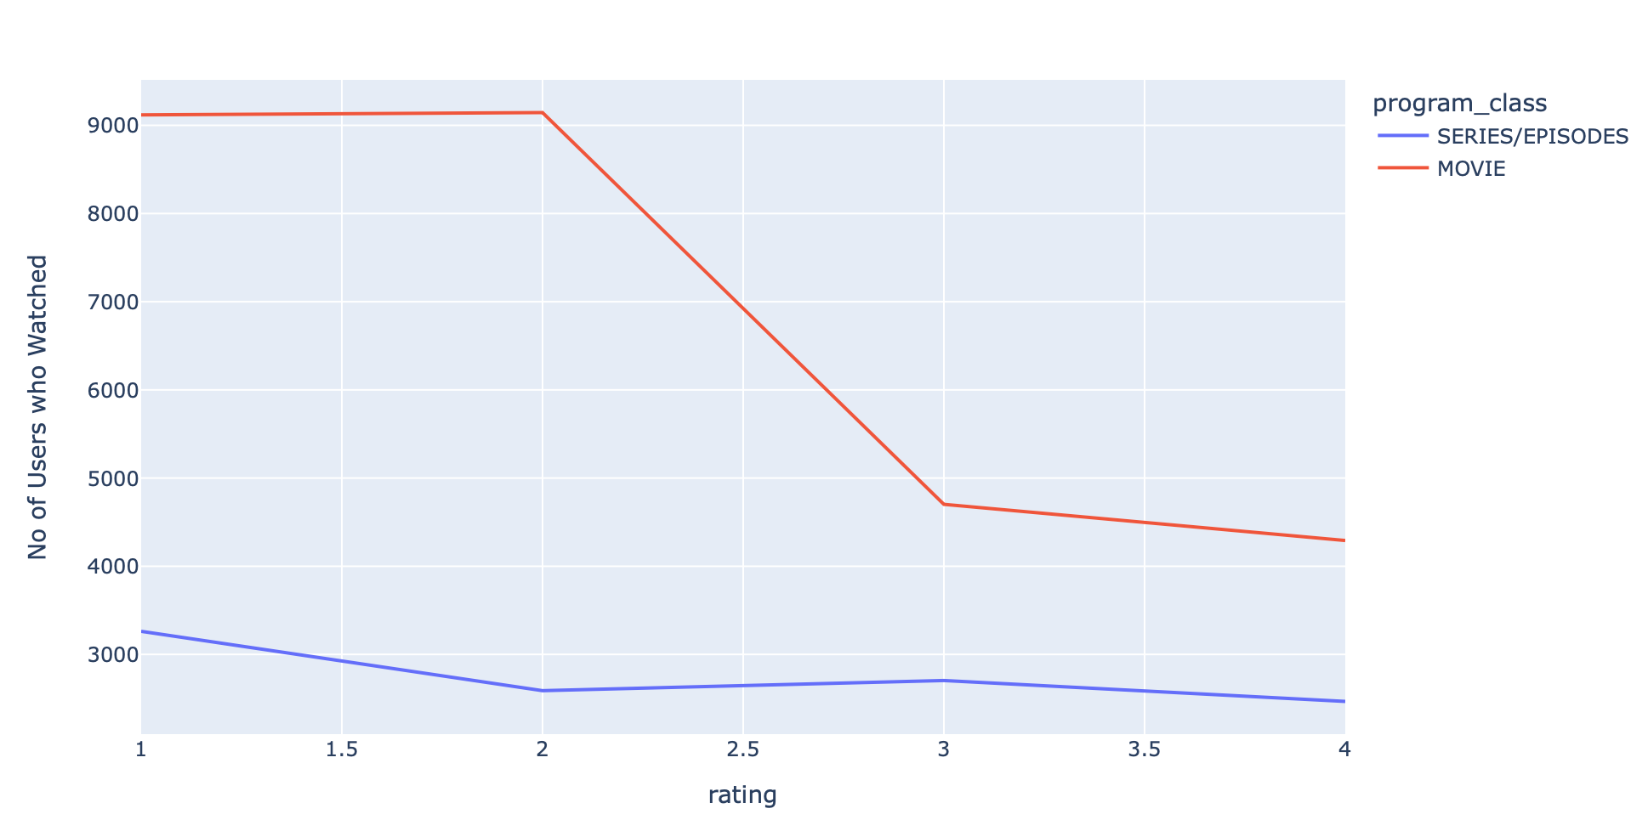

Slide 15
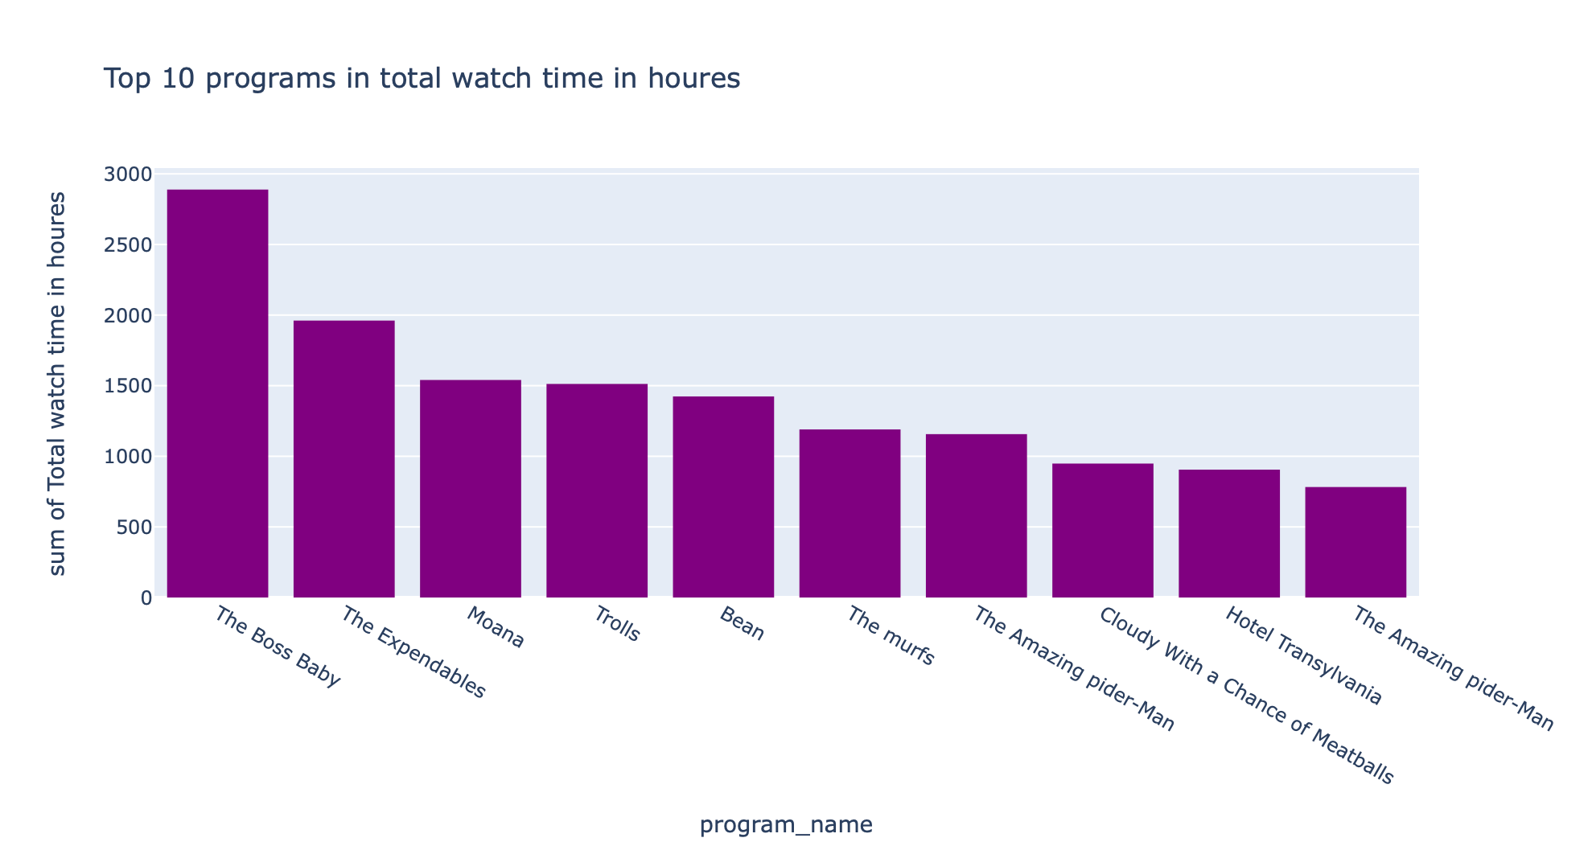

Slide 16
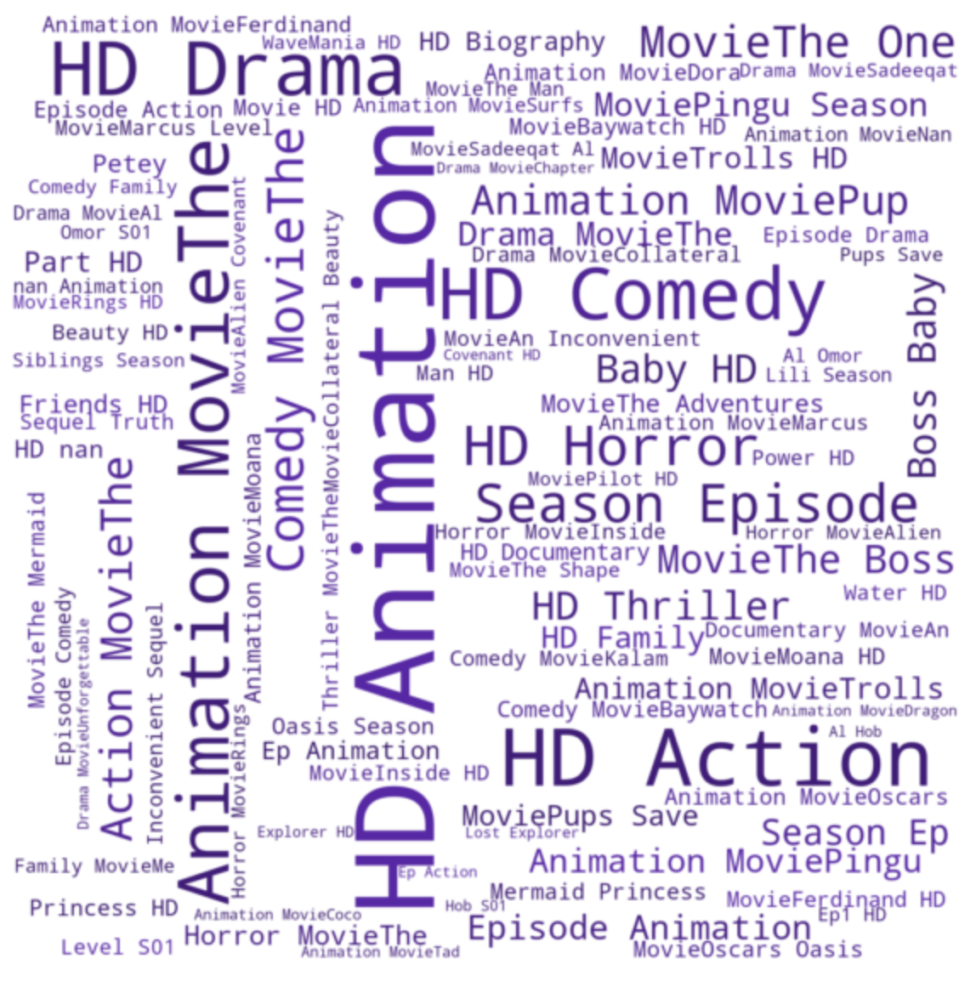
Word cloud

Slide 17

Preprocessing

Slide 18

Data gathering
libraries:
The selenium library helped in browsing the pages.
The Beautiful Soup library helped extract the description from the HTML tags.
The rich library helped track the progress and showed the estimated time.
Function to search the link for each name
Function to open each link and gathering the text description and save it in list with its name and url

Slide 19


Preprocessing
We add the rating column to the dataset and limit it to 1048575 rows
Reset the program_desc column to have this information (genre, class, name, hd)
Dropped the null and duplicated values unnecessary columns
Created a function that clean the text to prepare Vectorization
Apply CountVectorizer
(Converting a collection of text documents to a matrix of token counts) on the description text with max_df=0.80, min_df=2 parameters.

Slide 20

Recommendation Systems

Slide 21


Content-based
In the content-based recommendation system we created three functions:
The first one for the program description that contains (the movie name, movie class, movie genre, and whether it's HD or not),
The second function was for the description that we gathered from the web scrapping.
The third function contains both the program description and the description.
Collaborative Filtering
In the collaborative filtering, we used the user's ids, movies names, and ratings.

Slide 22

Results

Slide 23
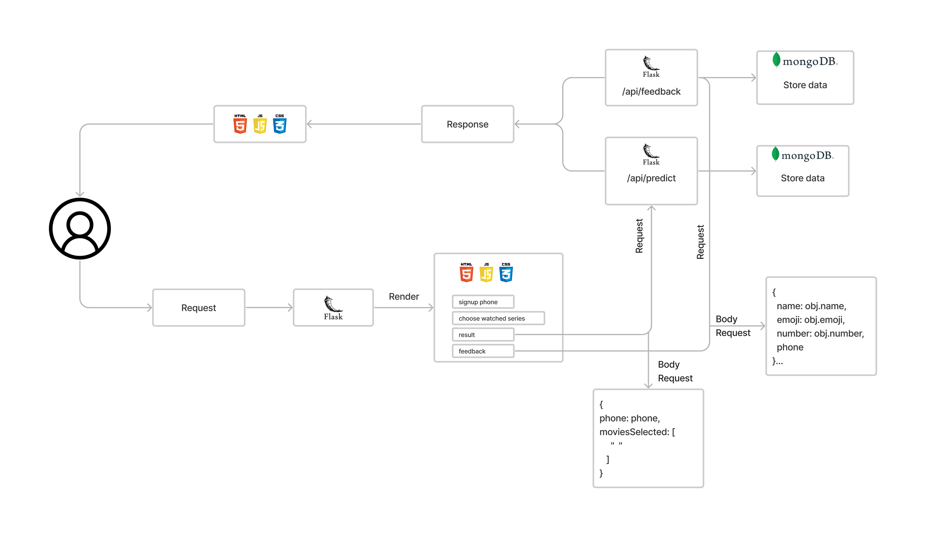
Real world project

Slide 24

Future work
Gathering pictures
Deploy the webpage in global server
Upload pictures for the results in webpage
Full dynamic frontend application
Using SQL with dataset

Slide 25
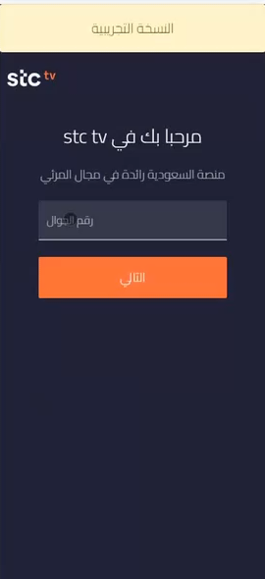

Slide 26
Thank you!
Do You Have Any Questions?

Slide 27
Contact Us
Ahuwaishel@gmail.com
Jumana.almussa@gmail.com
afnanalzahrani6@gmail.com
mahmoud.k.alhassan@outlook.com
Amjadalmusallam@gmail.com

